Slide 1
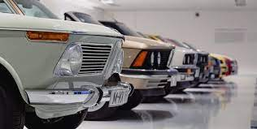
The Pakistan used car market

Slide 2
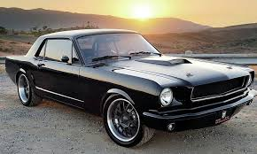
The Pakistan used car market is one of the largest and most dynamic markets in the world. With millions of cars sold every year, it is a key driver of the Pakistan economy and an important source of employment for thousands of people

Slide 3
Cost-effectiveness:
Buying a used car in Pakistan is generally more affordable compared to purchasing a brand new car. This allows individuals to own a vehicle at a lower cost, especially for those on a tight budget.
2. Variety of options:
The used car market in Pakistan offers a wide range of vehicle options, including different makes, models, and years. This allows buyers to choose from a diverse selection based on their preferences and requirements.
3. Depreciation advantage:
Unlike new cars that experience significant depreciation in their initial years, used cars have already undergone this depreciation. This means that the value of a used car tends to stabilize, resulting in a slower rate of depreciation for the buyer.

Slide 4
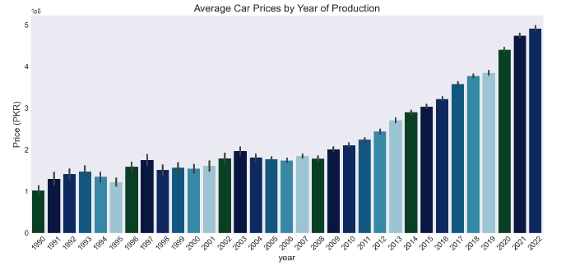
EDA
the Average Car Prices by Year of Production
Observation: It appears that the price is directly proportional to the car's manufacturing year, with newer cars having higher prices

Slide 5
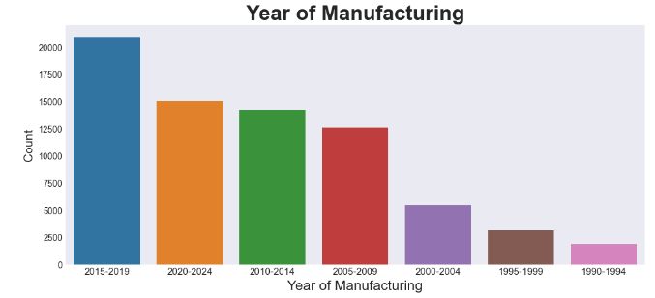
EDA
Are there more old cars for sale than new ones?
Observations: It appears that there is a direct correlation between the manufacturing year and the number of ads.Fewer cars listed on Pak Wheels have older manufacturing year

Slide 6
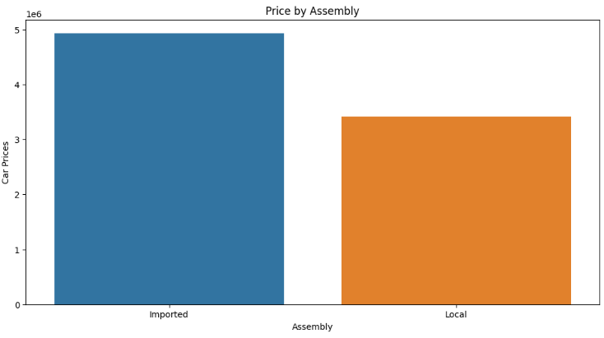
EDA
Price by Assembly
Observation: Locally assembled cars are cheaper than imported ones

Slide 7
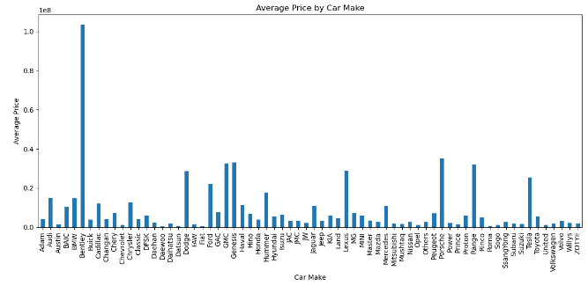
EDA
what is The most expensive make and model?
The most expensive make and model is ('Bentley', 'Mulsanne')

Slide 8
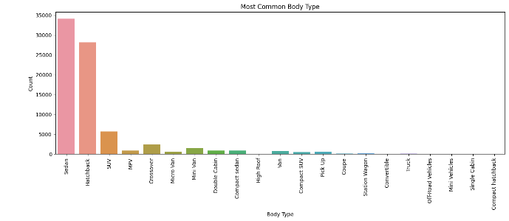
EDA
Most popular car body type
Observation: Sedan, hatchback and SUV holds more than 85% shares in Pakistani car industry

Slide 9
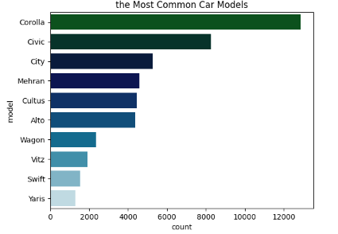
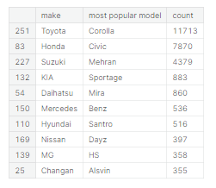
EDA
Most popular car model by top 10 manufacturer

Slide 10
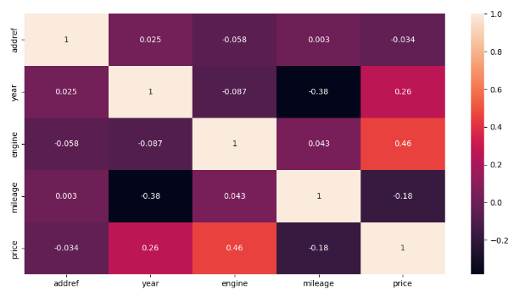
EDA
Is there a correlation between engine volume (engine_cc) and car price, and how strong is this correlation?
There is a correlation between engine volume (engine) and car price with a correlation coefficient of 0.46

Slide 11
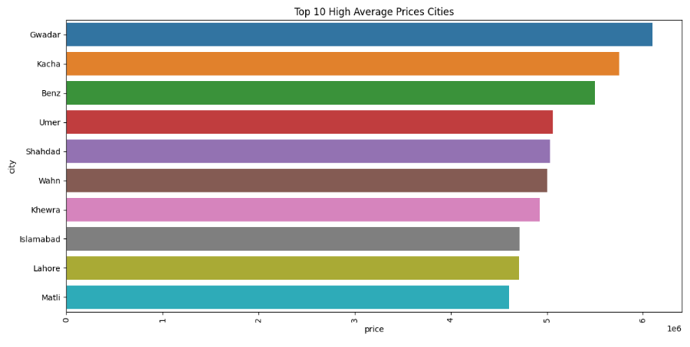
EDA
Top 10 city with the highest average car price

Slide 12
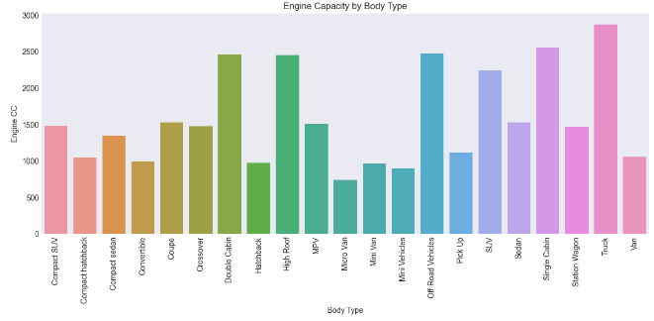
EDA
Observation: The majority of cars have engines ranging from 600 CC to 2000 CC

Slide 13
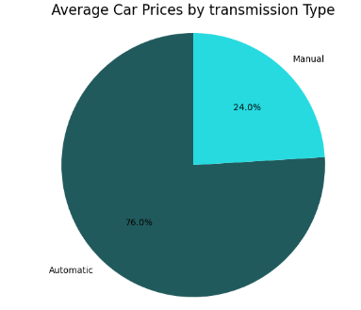
EDA
Average Car Prices by transmission Type

Slide 14
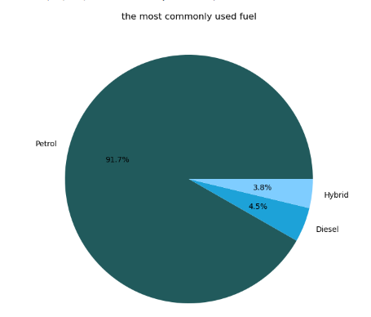
EDA
The most common fuel type is Petrol

Slide 15
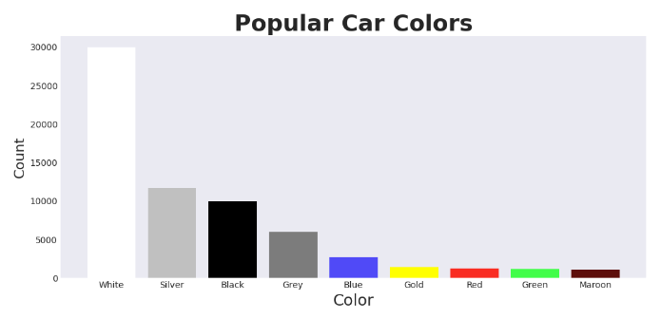
EDA
Popular Car Colors
Observation: White remains the most popular car color followed by silver, black and grey

Slide 16
suggestions to improve the used car market in Pakistan
Promote standardized vehicle inspections: Implement a standardized and reliable vehicle inspection system to assess the condition of used cars. This can help buyers make informed decisions and ensure that vehicles meet safety and quality standards
Foster a culture of maintenance and documentation: Encourage car owners to maintain proper documentation of their vehicles' service history and maintenance records. This can help increase the trustworthiness of used cars and provide buyers with valuable information about the vehicle's condition.
Improve access to financing options: Facilitate easier access to financing options for purchasing used cars. This can include working with financial institutions to develop specialized loan products with favorable terms for used car buyers.

